Slide 1
SOEN 341
User stories
Ref: Essential Scrum by Kenneth S. Rubin

Slide 2
Definition
User stories are short, simple description of a feature told by a user or designer. They typically follow a simple template:
As a <type of user>, I want <some goal> so that <some reason>.
They can be written at various levels of granularity and are easy to progressively refine.
They should be understandable to both business people and technical people

Slide 3
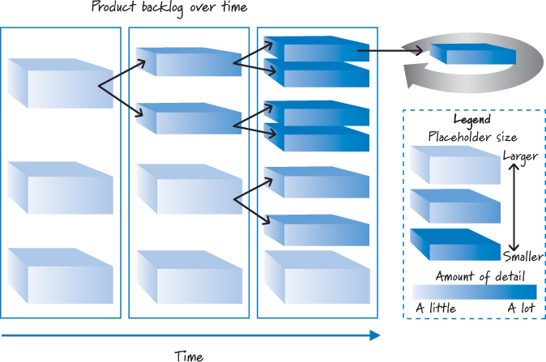
Product Backlog and Stories

Slide 4

Example

Slide 5
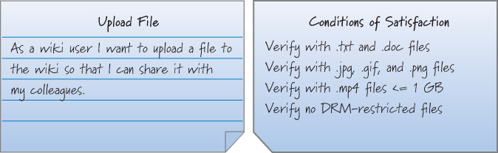
A user story may contain confirmation information in the form of conditions of satisfaction. These are acceptance criteria that clarify the desired behavior. satisfaction.
They can be used by the development team to better understand what to build and test and by the product owner to confirm that the user story has been implemented to his satisfaction

Slide 6
Example
One of the benefits of agile user stories is that they can be written at varying levels of detail. We can write a user story to cover large amounts of functionality. These large user stories are generally known as epics. Here is an epic agile user story example from a desktop backup product:
As a user, I can backup my entire hard drive.

Slide 7
Detail
Because an epic is generally too large for an agile team to complete in one iteration, it is split into multiple smaller user stories before it is worked on. The epic above could be split into dozens (or possibly hundreds), including these two:
As a power user, I can specify files or folders to backup based on file size, date created and date modified.
As a user, I can indicate folders not to backup so that my backup drive isn't filled up with things I don't need saved.

Slide 8
Detail=2
Detail can be added to user stories in two ways:
By splitting a user story into multiple, smaller user stories.
By adding “conditions of satisfaction.”
When a relatively large story is split into multiple, smaller agile user stories, it is natural to assume that detail has been added. After all, more has been written.

Slide 9
Level of Detail
Small stories used at the sprint level are too small and too numerous to support higher-level product and release planning.
At these levels we need fewer, less detailed, more abstract items. Otherwise, we’ll be mired in a swamp of mostly irrelevant detail.
if there is only one (small) size of story, we will be obligated to define all requirements at a very fine-grained level of detail long before we should

Slide 10
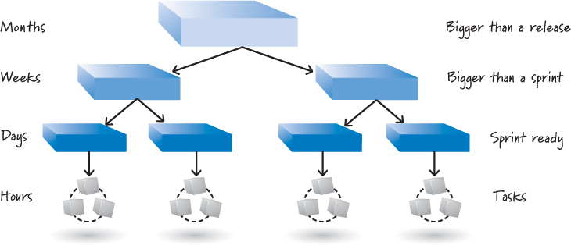
Stories can be written at multiple levels of abstraction. The largest could take a few to many months to implement and might span an entire release or multiple releases. Many people refer to these as epics

Slide 11
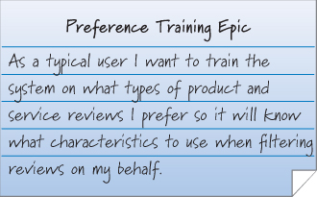
Epics give a very big-picture, high-level overview of what is desired

Slide 12
Epics
An epic would not be moved into a sprint for development because it is too big and not detailed.
Epics are excellent placeholders for a large collection of more detailed stories to be created at an appropriate future time.
The second level of abstraction of a story that could take weeks is called a feature.
The term theme can be used to refer to a collection of related stories. Themes provide a convenient way to say that a bunch of stories have something in common, such as being in the same functional area.

Slide 13
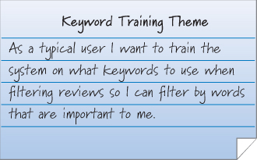
Theme This theme represents the collection of stories that will provide the details of how to perform keyword training

Slide 14
The INVEST criteria are Independent, Negotiable, Valuable, Estimatable, Small (sized appropriately), and Testable.
User stories should be independent or at least only loosely coupled with one another. Stories that exhibit a high degree of interdependence complicate estimating, prioritizing, and planning

Slide 15
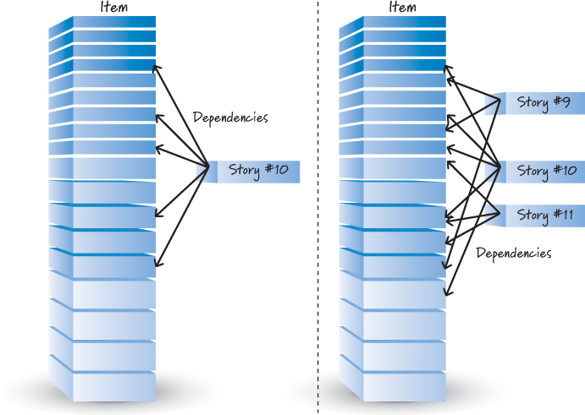
Story #10 depends on many other stories.

Slide 16
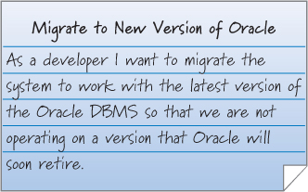
Negotiable, Valuable
Stories are not a written contract in the form of an up-front requirements document. Stories are placeholders for the conversations where the details will be negotiated.
Stories need to be valuable to a customer, user, or both.
Technical stories may be valuable

Slide 17
Estimatable, Small, Testable
Stories should be estimatable by the team that will design, build, and test them
Stories should be sized appropriately for when we plan to work on them. Stories worked on in sprints should be small.
Stories should be testable in a binary way—they either pass or fail their associated tests. Being testable means having good acceptance criteria

Slide 18
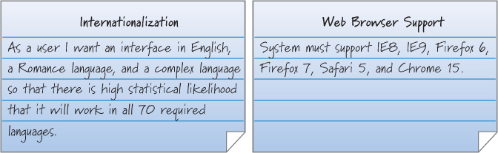
Nonfunctional Requirements
They represent system-level constraints. They are important because they affect the design and testing of most or all stories in the product backlog.

Slide 19
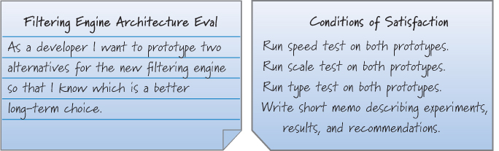
Knowledge-Acquisition Stories

Slide 20
Story Mapping
Decompose high-level user activity into a workflow that can be further decomposed into a set of detailed tasks

Slide 21
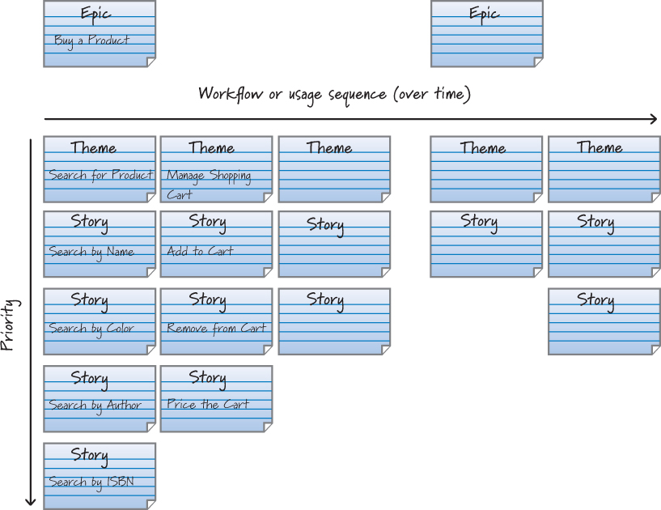

Slide 22
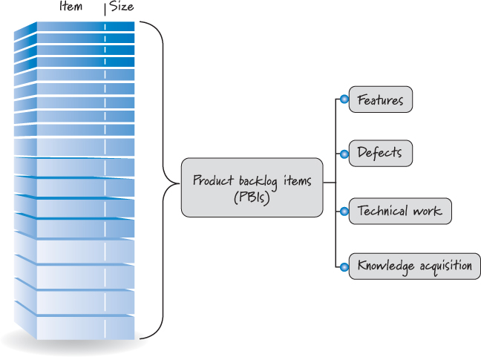
Backlog items

Slide 23
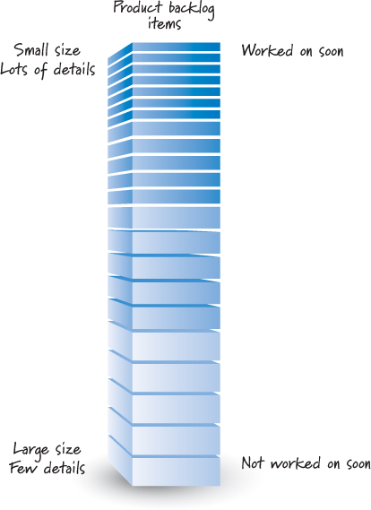
Not all items in a product backlog will be at the same level of detail at the same time

Slide 24
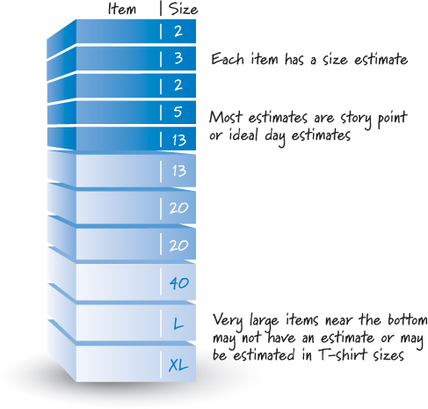
Each product backlog item has a size estimate corresponding to the effort required to develop the item

Slide 25
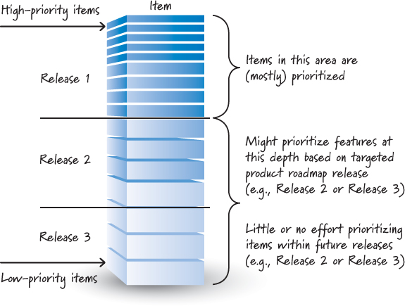
It is useful to prioritize the near-term items for the next few sprints.

